Slide 1
OOP Based Application
Shana Charlery

Slide 2
The brief
The aim is to create an OOP based application using CRUD method. Here the incorporation of tools methods and technologies was implemented.
Notes:
The application must be able to control and alter data via at two tables via the functionality of CRUD.

Slide 3
Solution
I chose to make a Christian website through Flask. The purpose of the website was for customers to be able to add information such as a motivation quote and they would be redirected to the home page, from there they would be able to see and read their quote.
Notes:
Talk about CR & UD in CRUD

Slide 4
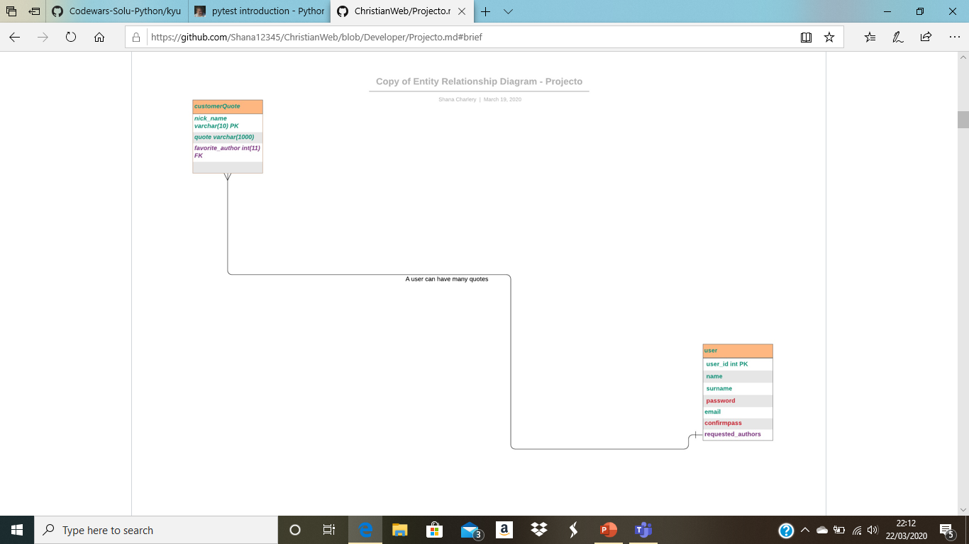
ERD
Notes:
Original ERD

Slide 5
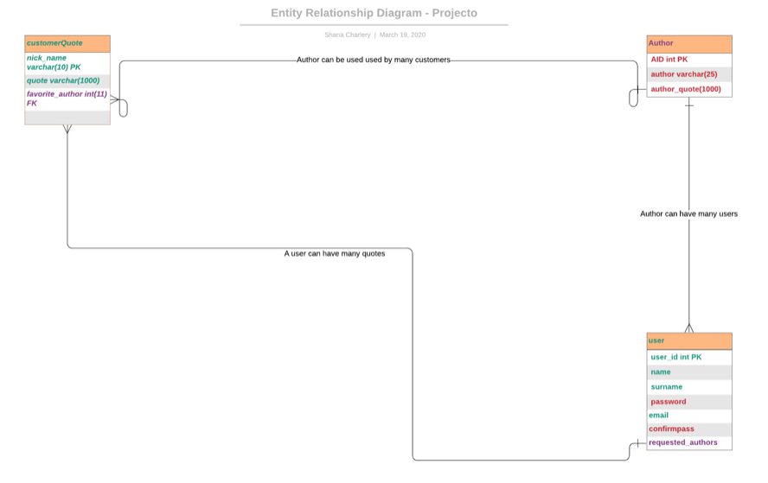
ERD Final

Slide 6
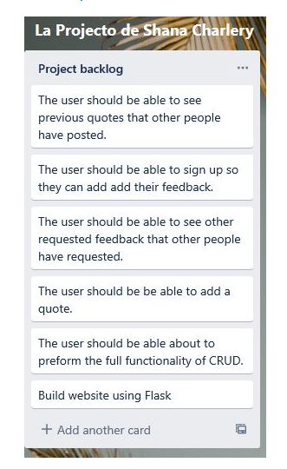
Product Backlog
Notes:
Here, is where all the requirments of the project are listed, though it isn't coloured coded here to show the list of priorties, as it was preferred to colour code the actually ERD diagram as it was a better way of prioritising.

Slide 7
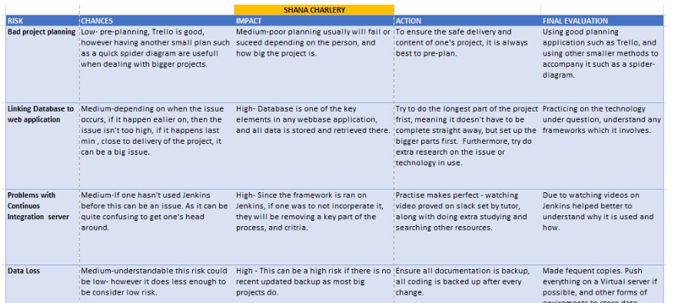
Risk Assessment

Slide 8
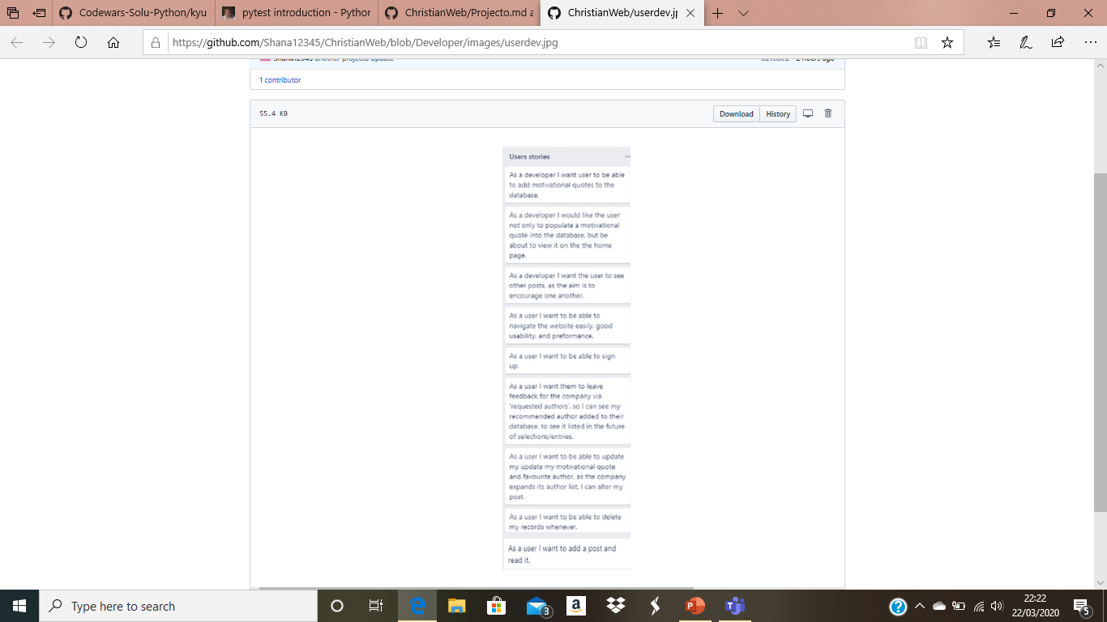
User & Developer

Slide 9
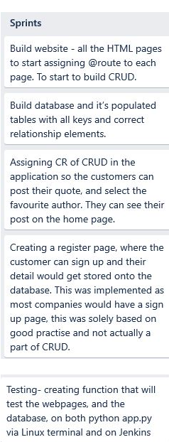
Sprints
Notes:
ach entry represents a sprint. Each sprint was roughly 4 days, however each needed to be met.

Slide 10
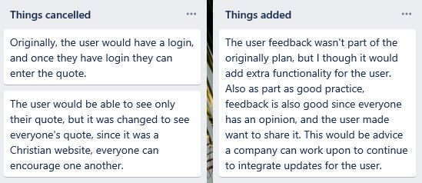
Things added & Cancelled

Slide 11
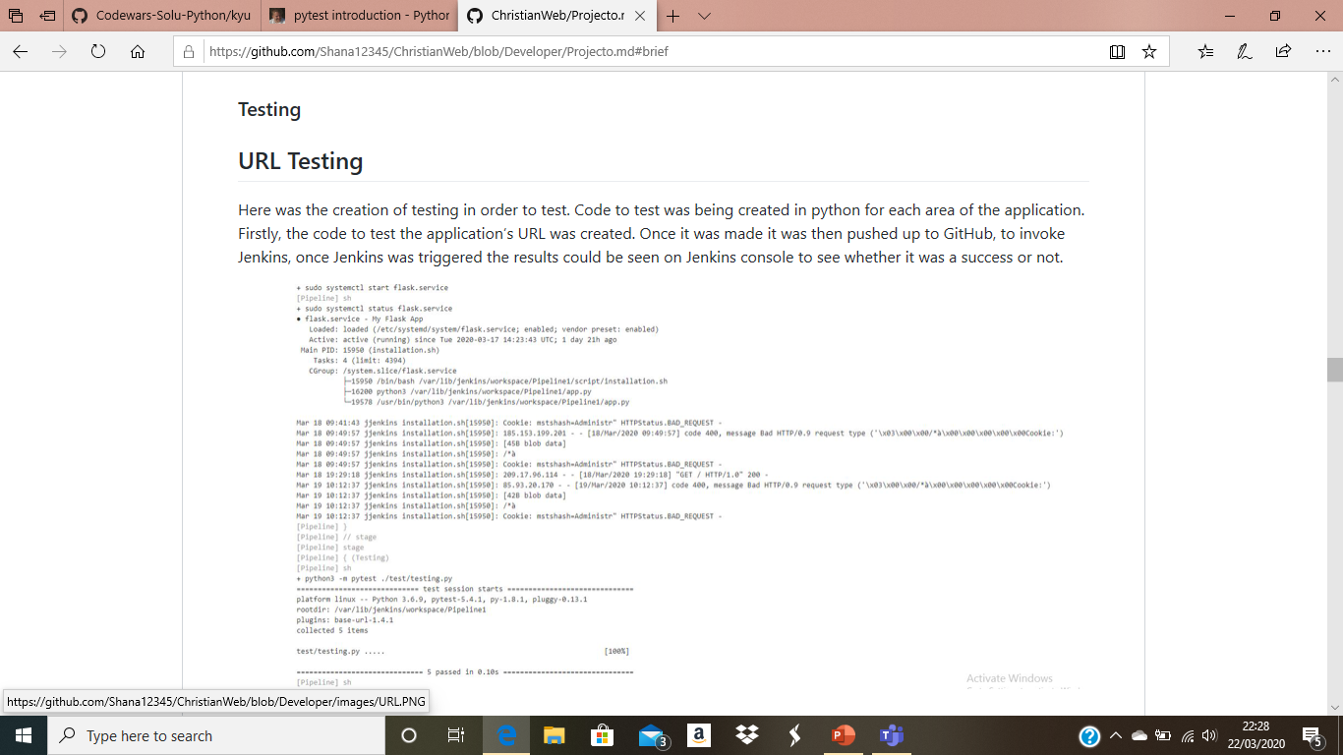
Jenkins URL Testing
Notes:
Here was the creation of testing in order to test. Code to test was being created in python for each area of the application. Firstly, the code to test the application’s URL was created. Once it was made it was then pushed up to GitHub, to invoke Jenkins, once Jenkins was triggered the results could be seen on Jenkins console to see whether it was a success or not.

Slide 12
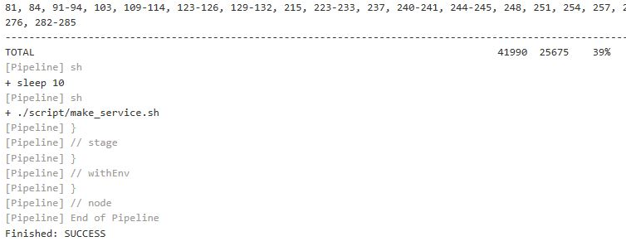
Database Testing and full coverage report Test coverage for the coverage report passed at 39%

Slide 13
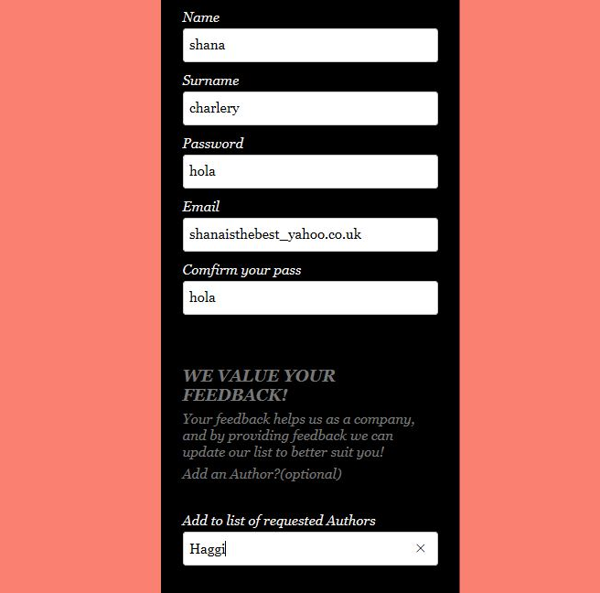
Registering and requesting a future author

Slide 14
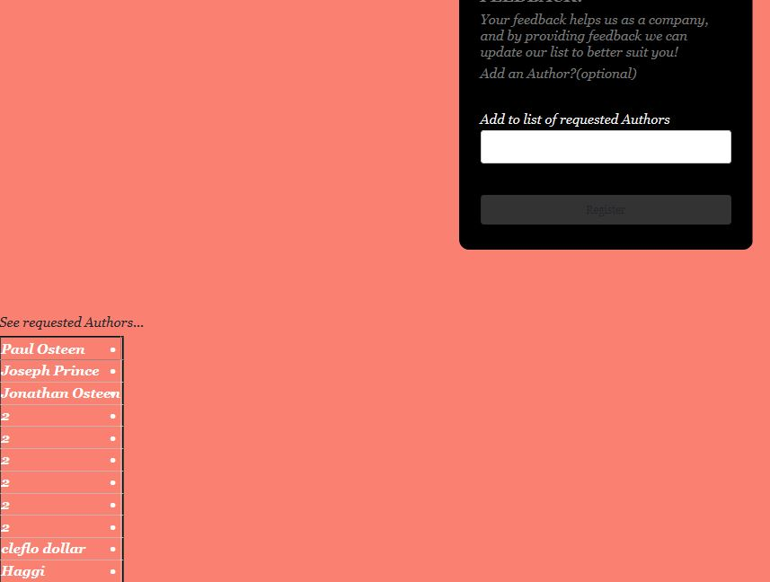
Requested author added

Slide 15
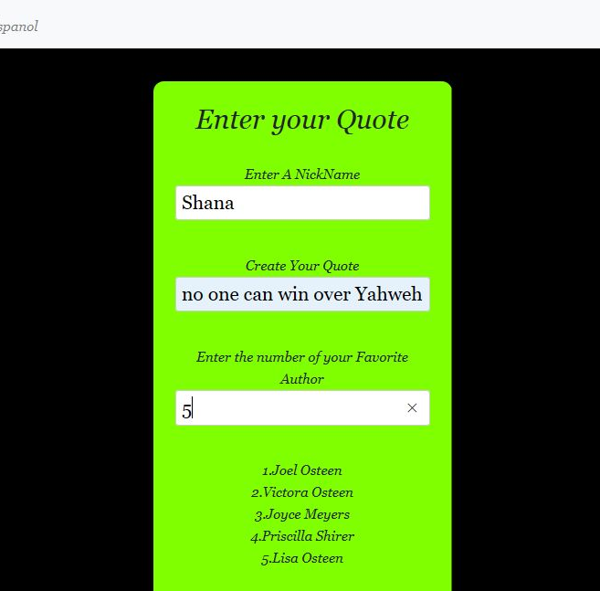
Entering a quote

Slide 16
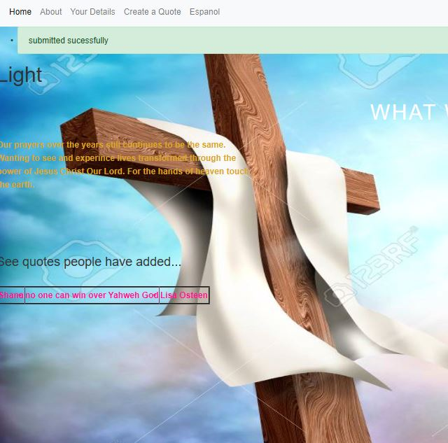
Quote Added

Slide 17
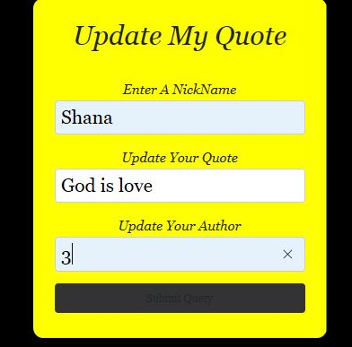
Updating my quote

Slide 18
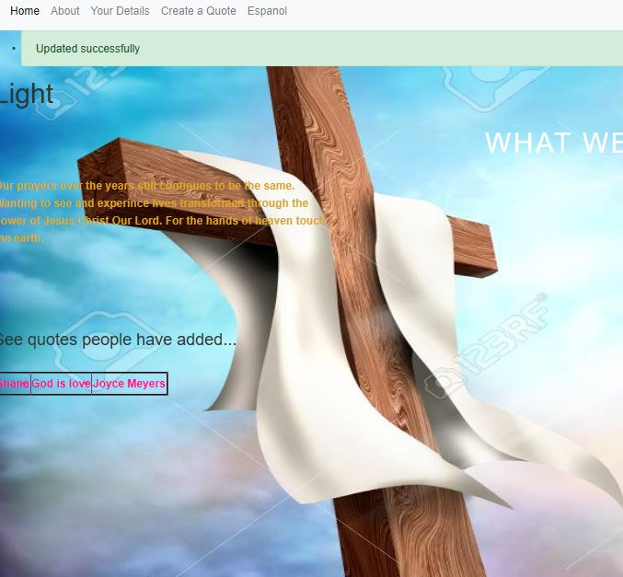
Quote Updated

Slide 19
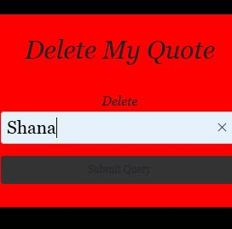
Delete a quote

Slide 20
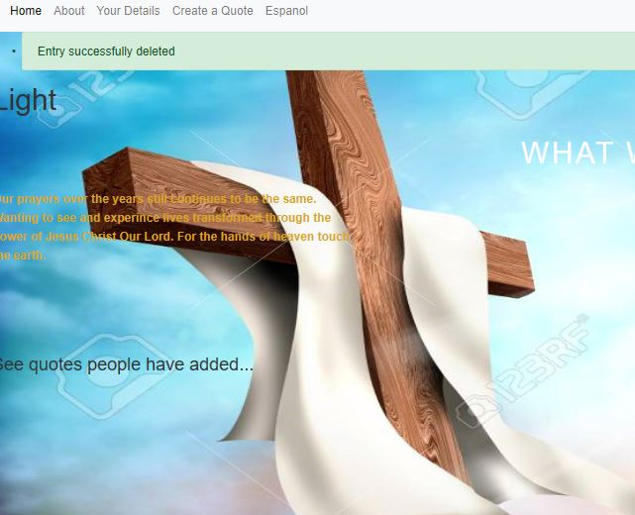
Quote Delete

